Slide 1

Python Modules
Kevin Cunningham

Slide 2
Plan for Session
Python Modules
Importing Modules
Using from with import
Main Module
Importing non-local modules
Module Search Path

Slide 3

Python Modules
A Python module is a file with
Variables and Functions
Classes and objects
Executable code
Attributes associated with the module such as its name
Module docstring (optional)
Name of a module is name of the file
(minus the suffix ‘.py’)
e.g. utils.py defines the module ‘utils’

Slide 4

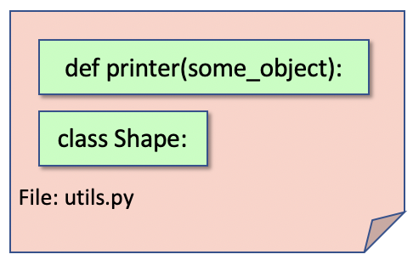
Python Modules
Example utils module contains
a function printer and a class Shape
utils.py
"""This is a test module""" print('Hello I am the utils module’)
def printer(some_object): print('printer') print(some_object) print('done')
class Shape: def __init__(self, id): self.id = id def __str__(self): return 'Shape - ' + self.id
default_shape = Shape('square')
Notes:
The module has a comment which is at the start of the file – this is useful documentation for anyone working with the module. In some cases, the comment at the start of the module can provide extensive documentation on the module such as what it provides, how to use the features in the module and examples that can be used as a reference.
The module also has some executable code (the print statement just after the comment) that will be run when the module is loaded / initialised by Python. This will happen when the module is first referenced in an application.
A variable default_shape is also initialised when the module is loaded and can also be referenced outside the module in a similar manner to the module’s function and class. These variables can be useful in setting up defaults or predefined data that can be used by developers working with the module.

Slide 5
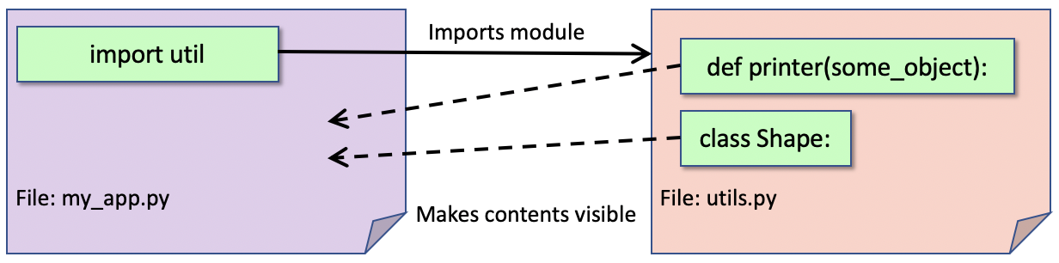
Importing a Module
Most modules are not automatically imported
must explicitly import them
using the import statement
note use the name of the module (not the file)
Can use utils module within code
import utils
import utils
utils.printer(utils.default_shape) shape = utils.Shape('circle') utils.printer(shape)

Slide 6
Importing a Module
What happens when we run code
Note the free-standing code executed
when the module was first imported
i.e. ran print('Hello I am the utils module’)
and initialised the default_shape
Then the application code ran
import utils
utils.printer(utils.default_shape) shape = utils.Shape('circle') utils.printer(shape)
Hello I am the utils module
printer
Shape - square
done
printer
Shape – circle
done

Slide 7
Importing a Module
There can be any number of modules imported
can be both user defined modules and system provided modules
modules can be imported via separate import statements or
by supplying a comma separated list of modules
Common convention is to place all import statements at the start of a file
however, this is only a convention and
import statements can be placed anywhere in a file prior to where the modules features are required
although most IDEs (e.g. PyCharm) will indicate this as a style issue
import utils
import support
import module1, module2, module3

Slide 8
Importing from a Module
Previous examples still required name of module
Can avoid this using from <module name> import *
Can now reference module contents directly
Or can import only those elements of interest
Can provide aliases
from utils import *
printer(default_shape) shape = Shape('circle') printer(shape)
from utils import Shape
s = Shape('rectangle') print(s)
import utils as utilities utilities.printer(utilities.default_shape)
from utils import printer as myfunc
Notes:
Can hide some elements
wildcard import will import everything
unless an element starts with an underbar (_)
now it must be imported explicitly
"""This is a test module""" print('Hello I am the utils module')
# as before ...
def _special_function(): print('Special function’)
from utils import _special_function
_special_function()

Slide 9
Main Module
When a module is loaded any free standing code will execute
May only want this to happen if the module is the entry point to the program
When module is entry point then it has a special name '_ _main_ _ '
Can test for this and only run code if the module is being run as the main module
Common idiom in Python programs
if _ _name_ _ == "_ _main_ _":
print('Only run if main module')

Slide 10
Main Module
Common to define a function called main()
invoked when run as main module
from utils import * def main(): printer(default_shape) shape = Shape("circle") printer(shape) if __name__ == "__main__": main()

Slide 11
Importing non-local Modules
Built-in or 3rd party modules
can be imported via their name
The sys module is a built-in module
provides information about the system
import sys print('sys.version: ', sys.version) print('sys.maxsize: ', sys.maxsize) print('sys.path: ', sys.path) print('sys.platform: ', sys.platform)
sys.version: 3.9.4 (default, Apr 5 2021, 01:50:46)
[Clang 12.0.0 (clang-1200.0.32.29)]
sys.maxsize: 9223372036854775807
sys.path: […]
sys.platform: darwin

Slide 12
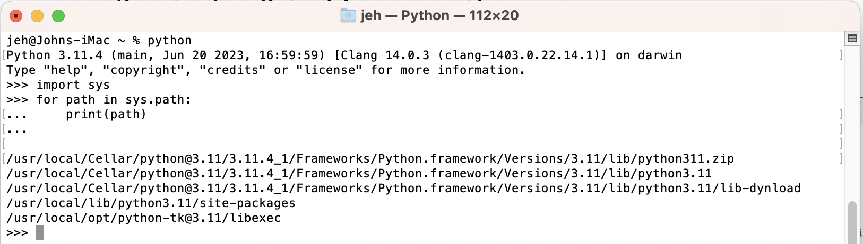
Python Module Search Path
Python will search for libraries in
current directory
note can therefore hide a module / library
directories listed in sys.path
The sys.path
set up when Python starts up
may reference a virtual environment

Slide 13
Questions?
?

